Slide 1
MSK Care to drive improved outcomes for your employees and deliver lower costs to your organization

Slide 2


OrthoLive Offers a Solution That Hasn’t Existed Until Now

Slide 3

The Problem
45% of work-related injuries are related to musculoskeletal disorders (MSDs)—things like sprains or strains that are often caused by repetitive motions
MSDs account for the #1 employer spend across multiple industries
MSDs are more likely to occur during an employee’s first 6 months
MSK Disorders
Notes:
We agree with you!

Slide 4


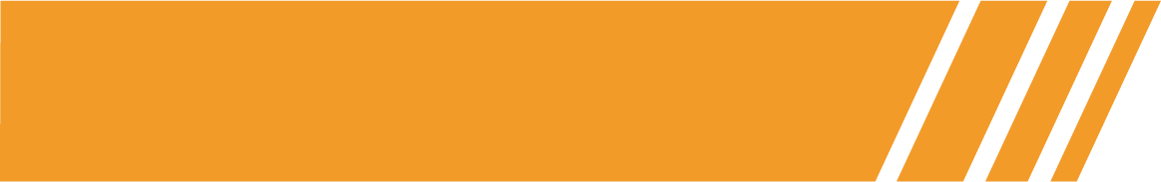
Solution
Ortho
Clinic in the Cloud
Building the Complete MSK Healthcare Solution
TM
OrthoLive’s digital, virtual, and in-person Musculoskeletal clinic is a hybrid solution that empowers skilled providers with technology, expedited care and reduction of costs for patients, payers, and employers while driving better outcomes through multiple tiers of care.
OrthoLive’s Remote Injury Care (RIC) saves employers on average over $5k per injury in direct injury costs. Average injury cost is less than $500
OrthoLive helps reduce treatment delays, high MSK spend on chronic diseases, expedites access to expert medical advice, accelerates return to work, reduces OSHA recordable events and insurance premiums, and reduces employers and payers’ costs with its Remote Injury Care (“RIC”) services.
The company is currently executing on its vision connecting and aligning top providers and technologies through the OrthoLive Clinically Integrated Network (“CIN”).
Notes:
Today, digital therapeutics (DTx) vendors are utilizing scalable technology to create digital MSK programs that address the problem. These programs offer effective pain relief to members while reducing their reliance on surgical interventions.

Slide 5
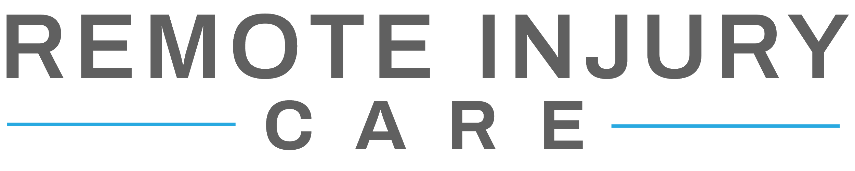
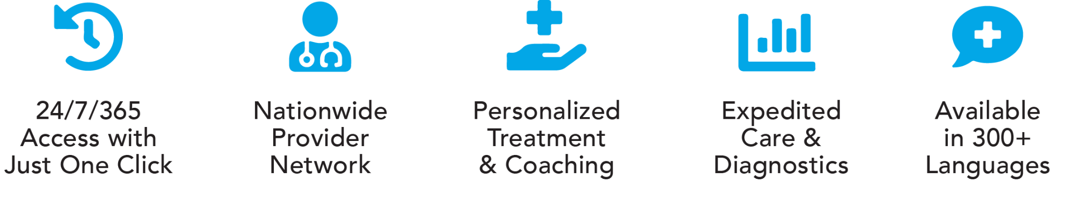

Slide 6
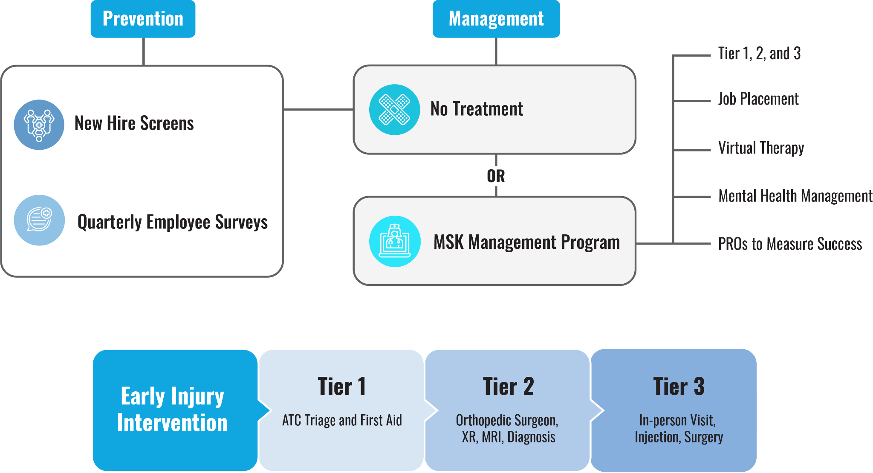
Complete MSK Solution Workflow

Slide 7
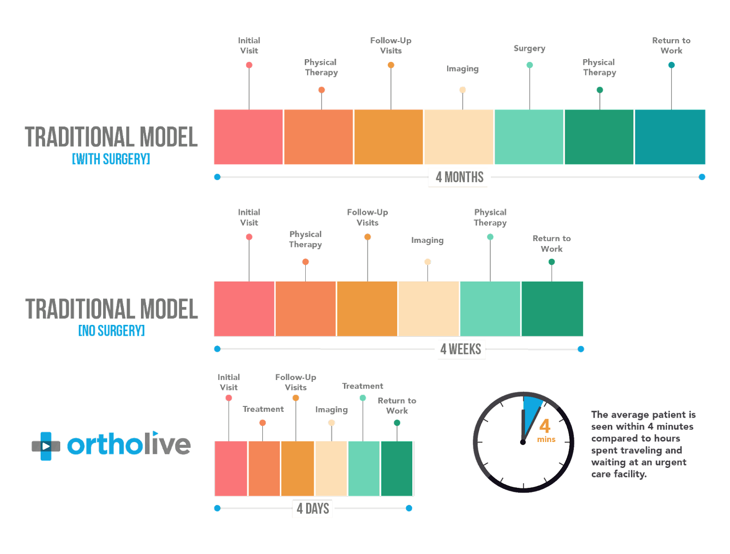

Slide 8
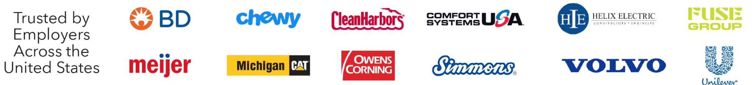
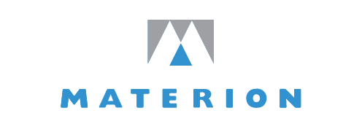
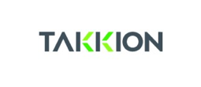
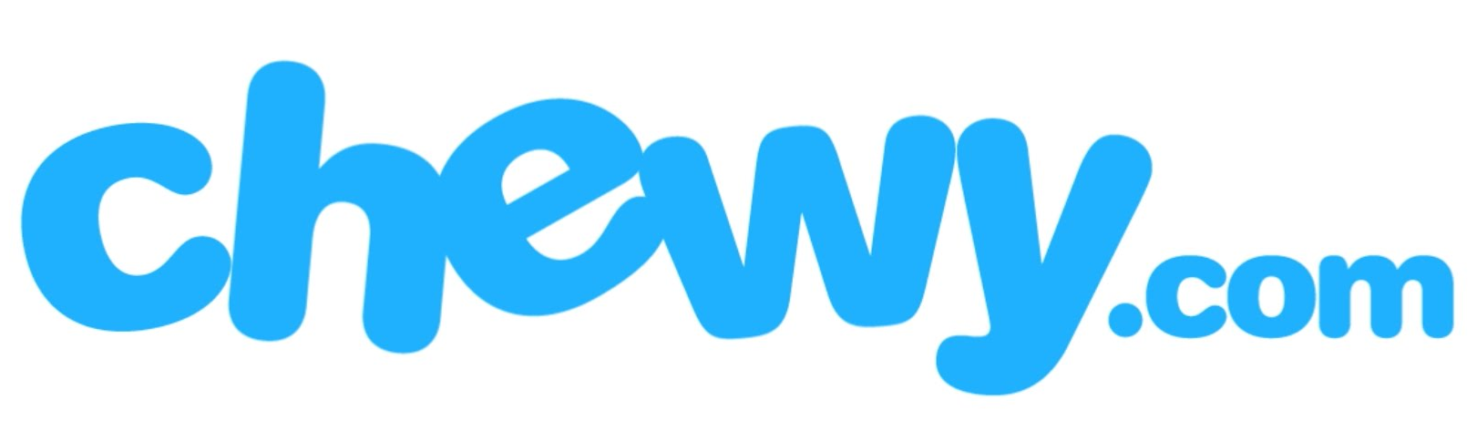


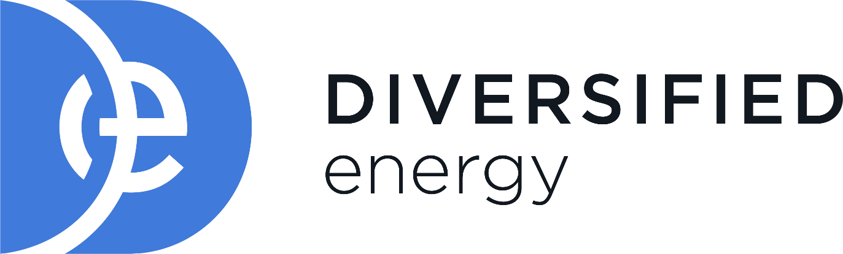

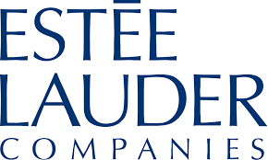
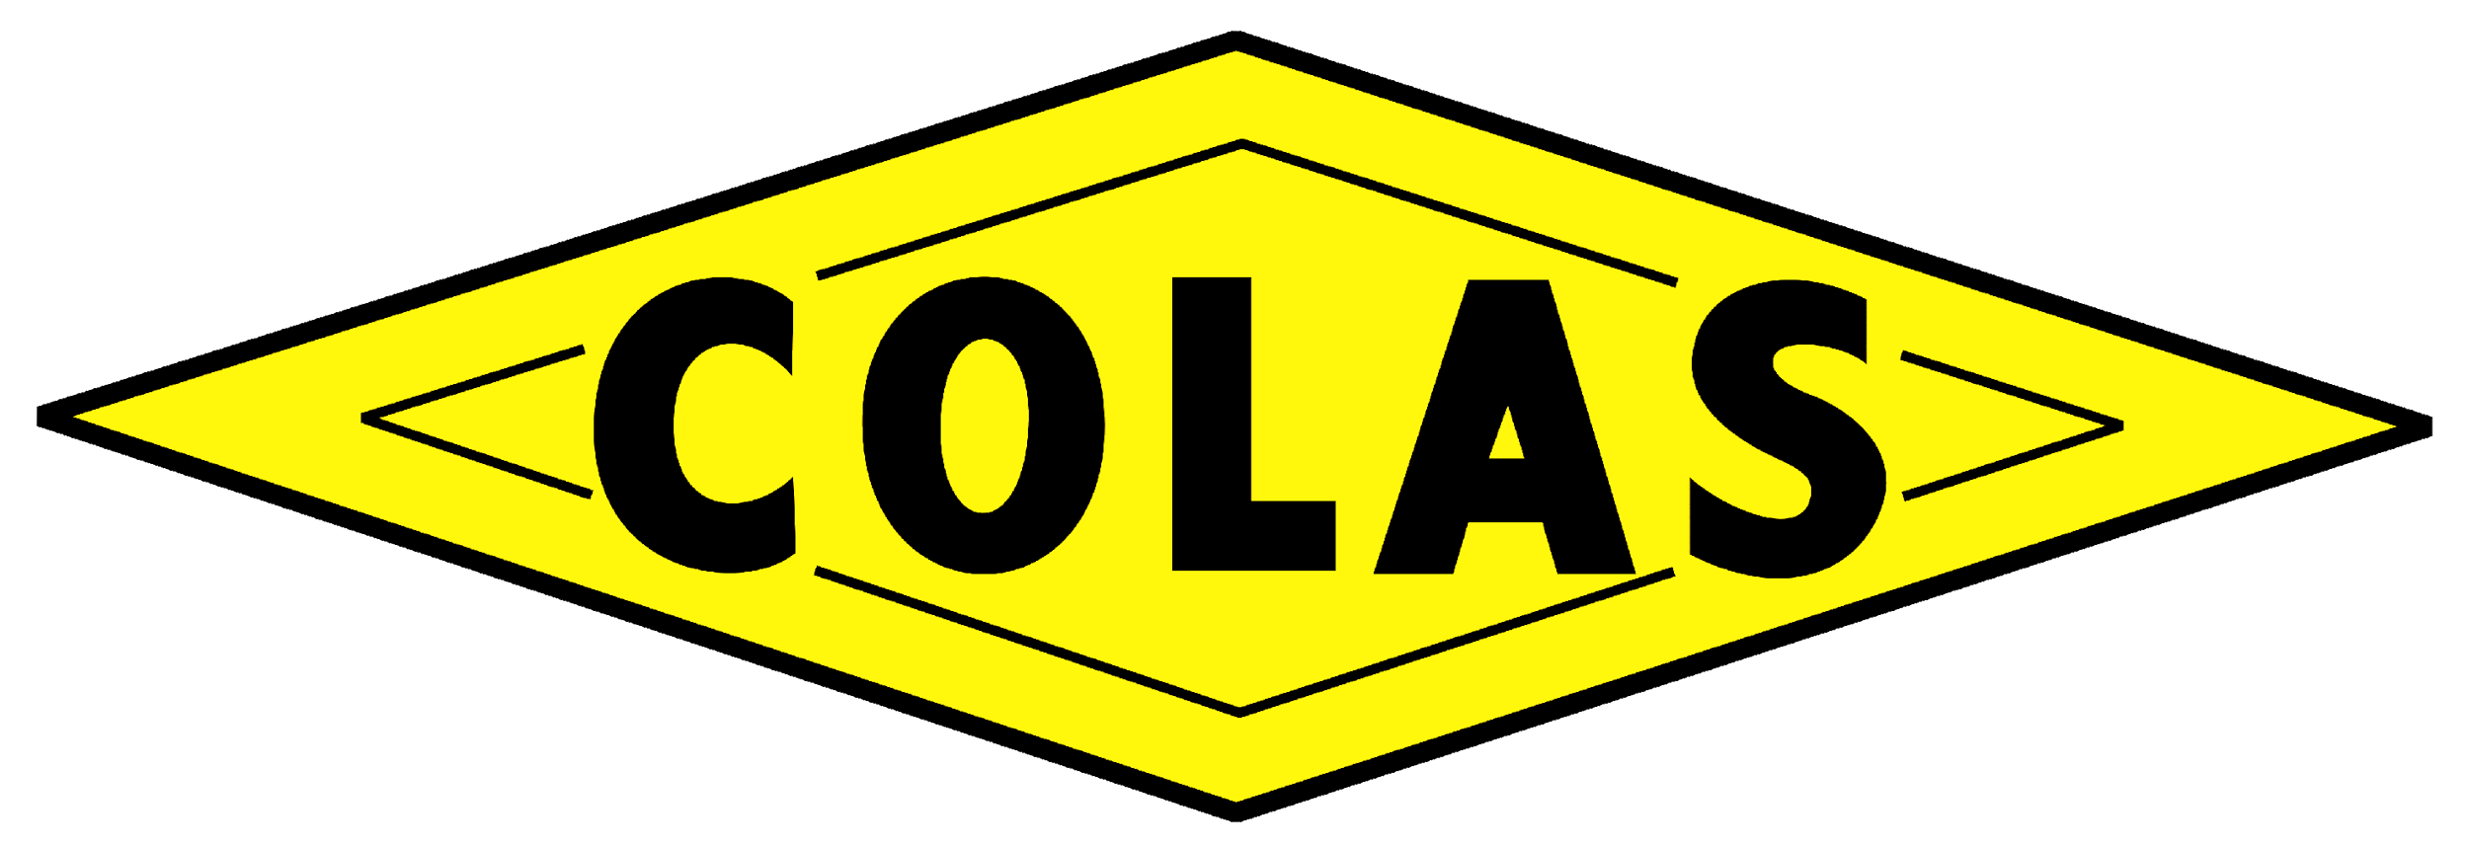
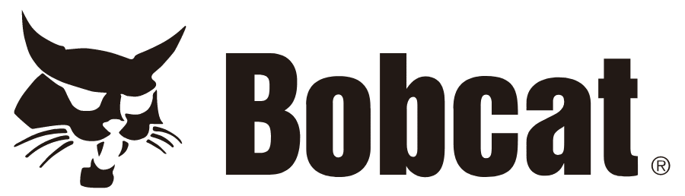
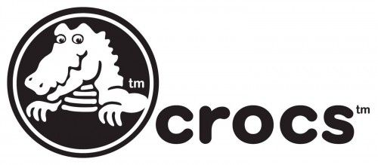
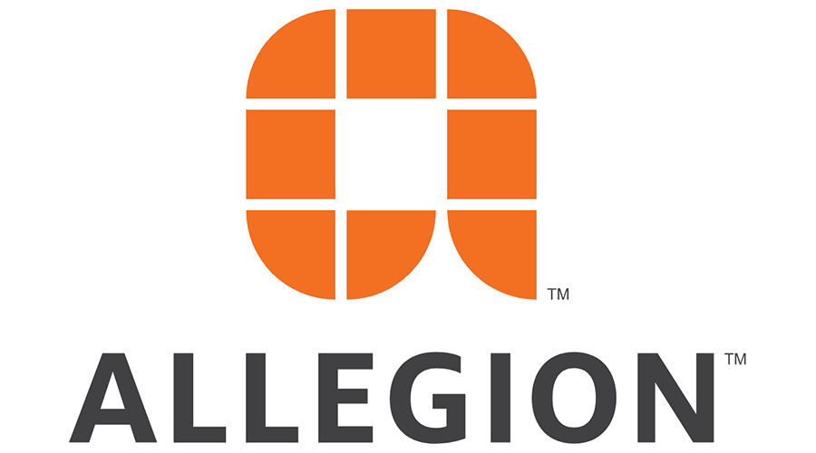
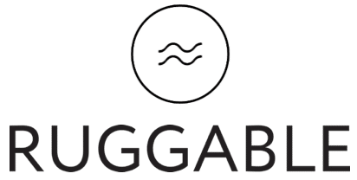

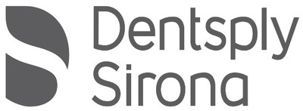
Trusted by Employers Across the U.S.

Slide 9
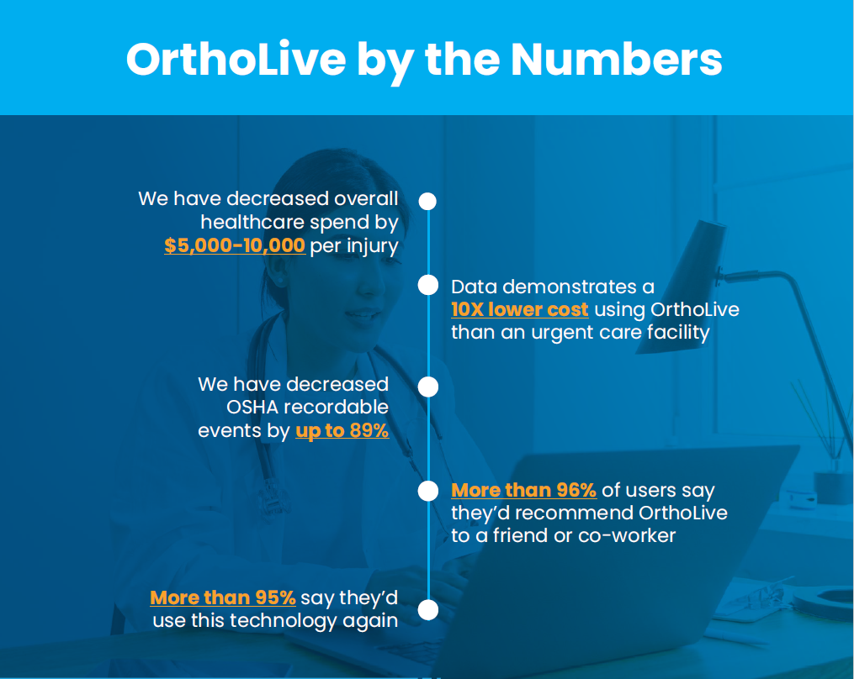
Traction
Building the Complete MSK Healthcare Solution
Accomplishments to Date:
~300 Employers; ~2,400 locations; 2.5M lives
Nationwide Network of Providers
Partnerships (Technology, RTM, Analytics)

Slide 10
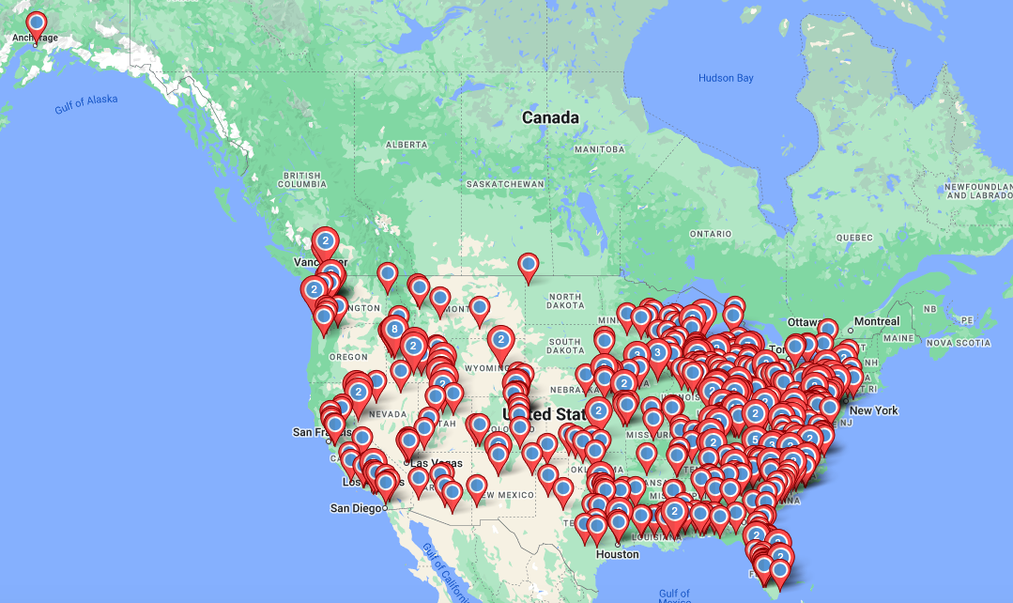
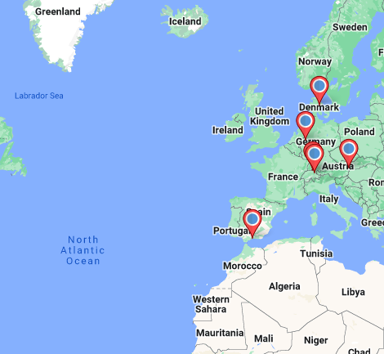
Traction
Building the Complete MSK Healthcare Solution
US Employer Locations
European Employer Locations

Slide 11
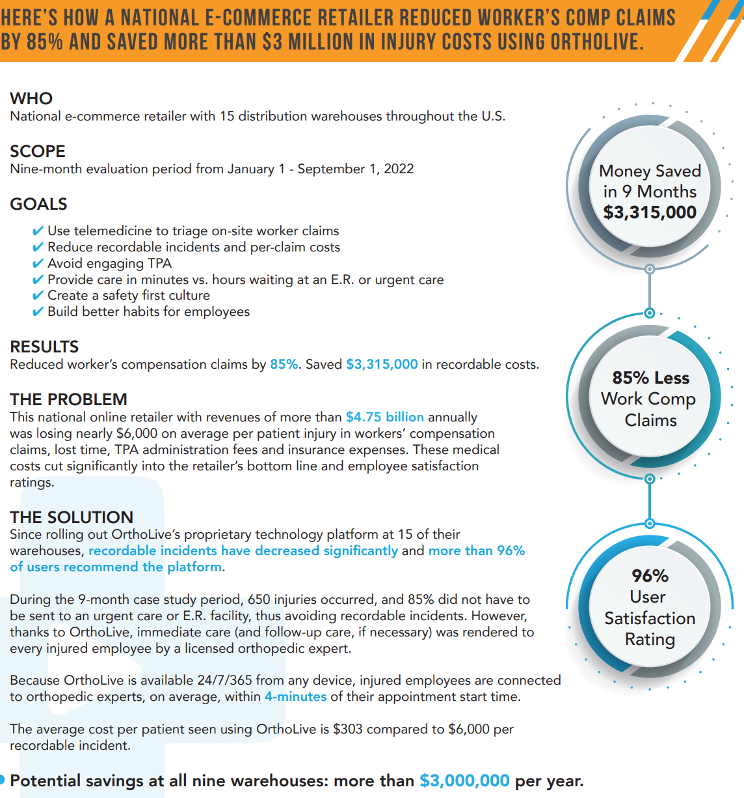

Slide 12

Chewy Case Study: Early Intervention

Slide 13
Chewy Case Study
Injury Types
Injury Type | Recordables | Total
Strain | 25 | 162
Contusion | 9 | 53
Sprain | 3 | 43
Strain -Disc | 3 | 18
Disc | 6 | 11
Other | 1 | 9
Fracture | 1 | 1
Laceration | 0 | 1

Slide 14
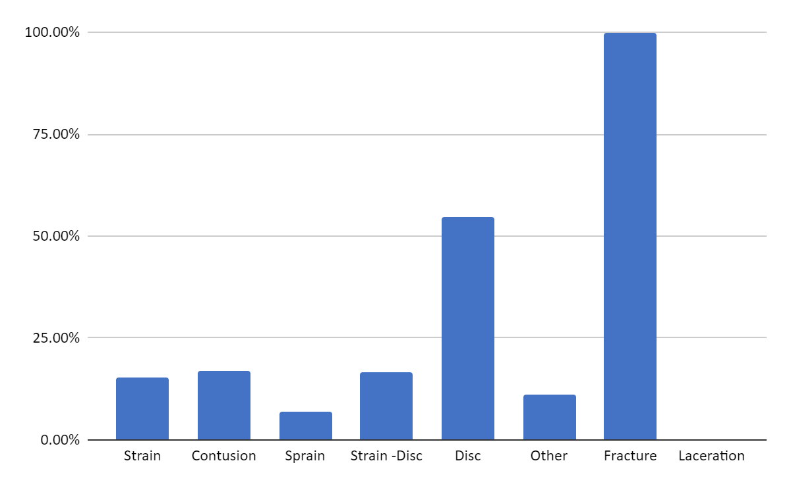
Chewy Case Study
Recordable Rate by Injury Type

Slide 15
Chewy Case Study
After first 650 patients seen by OrthoLive
Pre OrthoLive- $6000 per recordable
With OrthoLive- $303 per patient seen at OrthoLive
95% reduction in claims cost

Slide 16
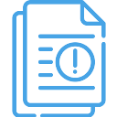

Mainscape Case Study
2022 Success
National Landscaping Company
14 states
3,000+ employees
$1,062
$443
35% red.
2021 cost per claim
2022 cost per claim
Recordables
“We love the support, the easiness of the process, and great communication “

Slide 17
OrthoLive Client Improvement
Mainscape
The following is the breakdown of Total Cost/Average Cost Per Claim with our previous provider:
Previous Provider
  2019 = $101,250 spent on 125 Claims = $810.00 (avg cost per claim)
  2020 =-$123,250 spent on 116 Claims = $1062.50 (avg cost per claim)
With OrthoLive
  2021 – 2022 (12 Months) $50,059- 113 Claims- $443.00 (avg cost per claim)
OSHA Recordable Rate for cases that went to other provider vs OrthoLive
  Other Provider - 58%
  Ortholive - 38%
“As I stated before we love the support, the easiness of the process, and the great communication.”
Notes:
At each “?” we evaluate the patients condition and if any further treatment is necessary.

Slide 18
Unilever Case Study
2022 Success
37,000 US employees
14 locations
88%
5/5 Stars
69%
Non-recordable
Patient Satisfaction
ATC only
Bonus: “We know more than a handful of cases were kept from the ER”

Slide 19
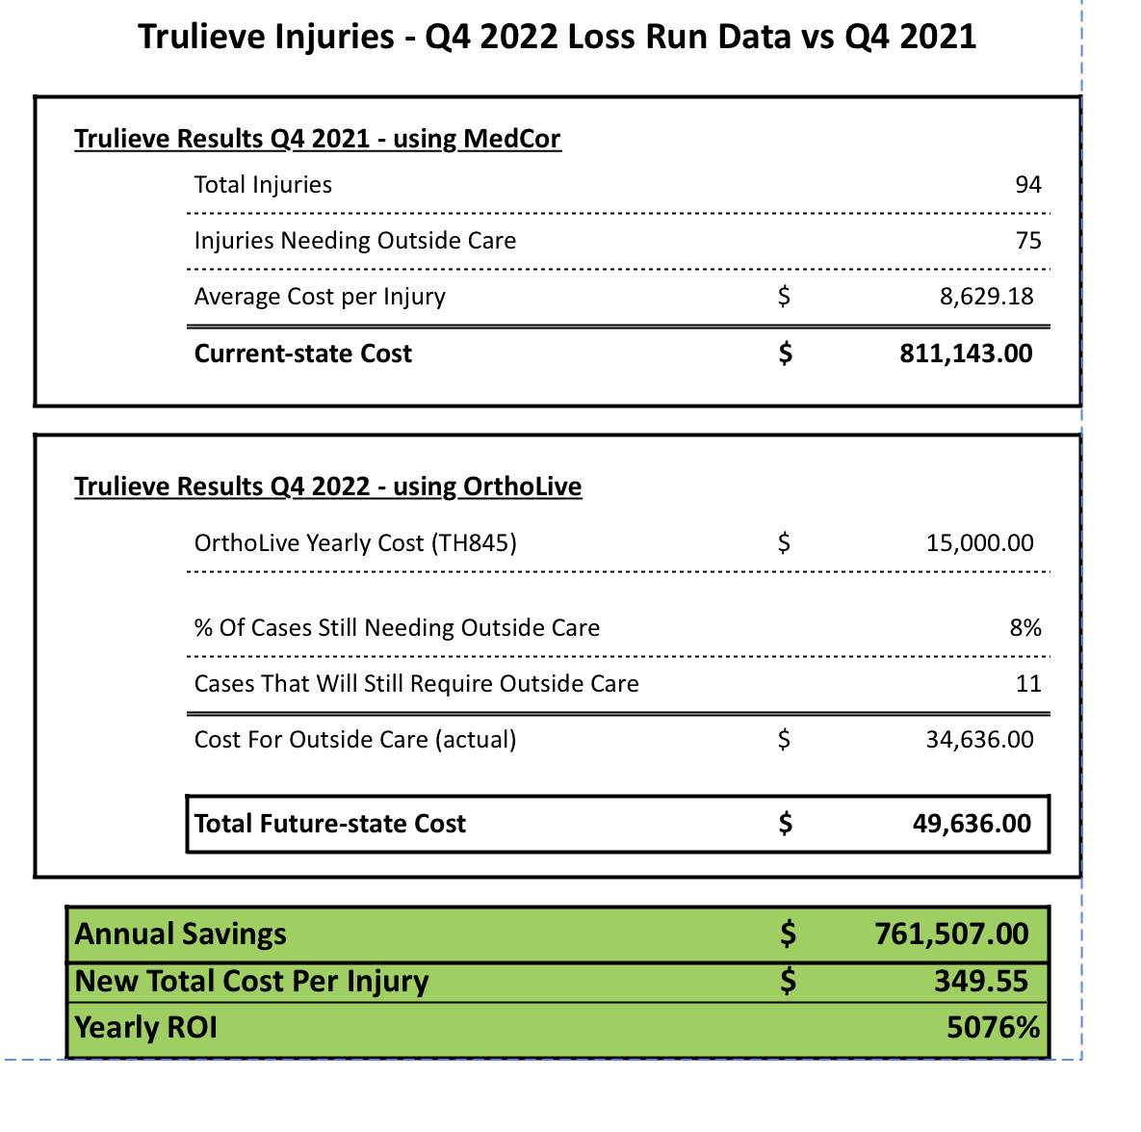
OrthoLive treated 70 injuries

Slide 20
Owens Corning Case Study
2022 Success
17,000 North American employees
60+ locations
79% +
$250
6
Non-recordable
Cost per case
References
Owens Corning screened over 150 new employees for pre existing MSDs

